Slide 1
Word2Vec in 9 slides
Tomas Mikolov, Ilya Sutskever, Kai Chen, Greg Corrado, Jeffrey Dean
Presenter: Sungjoon Choi

Slide 2
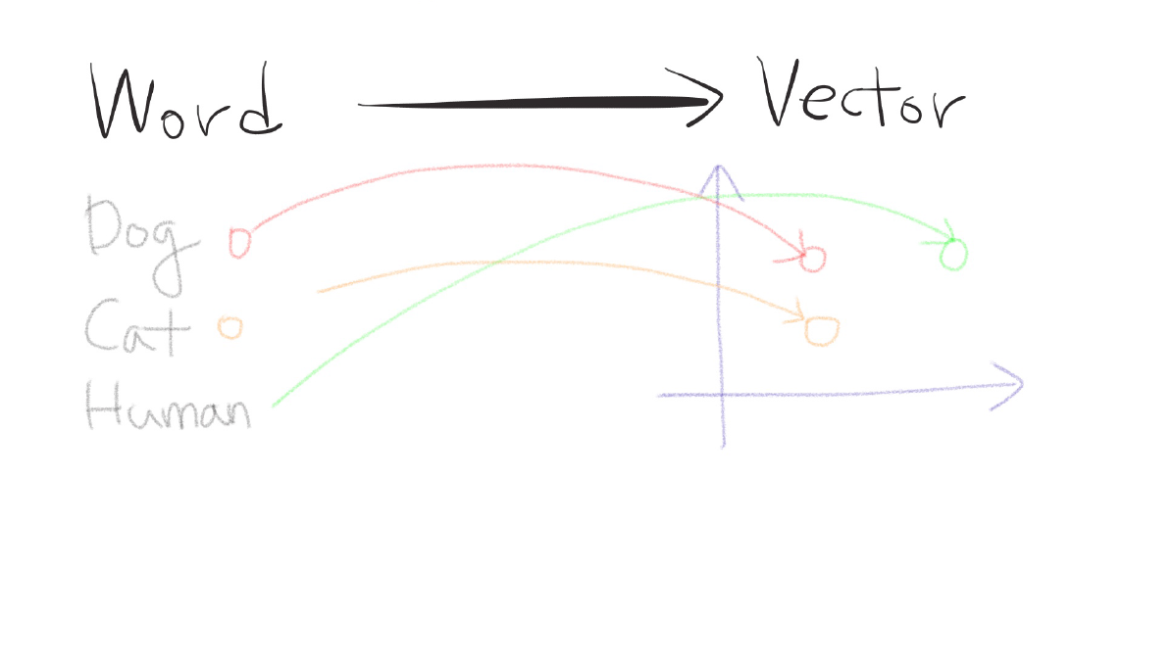
Word2Vec?

Slide 3
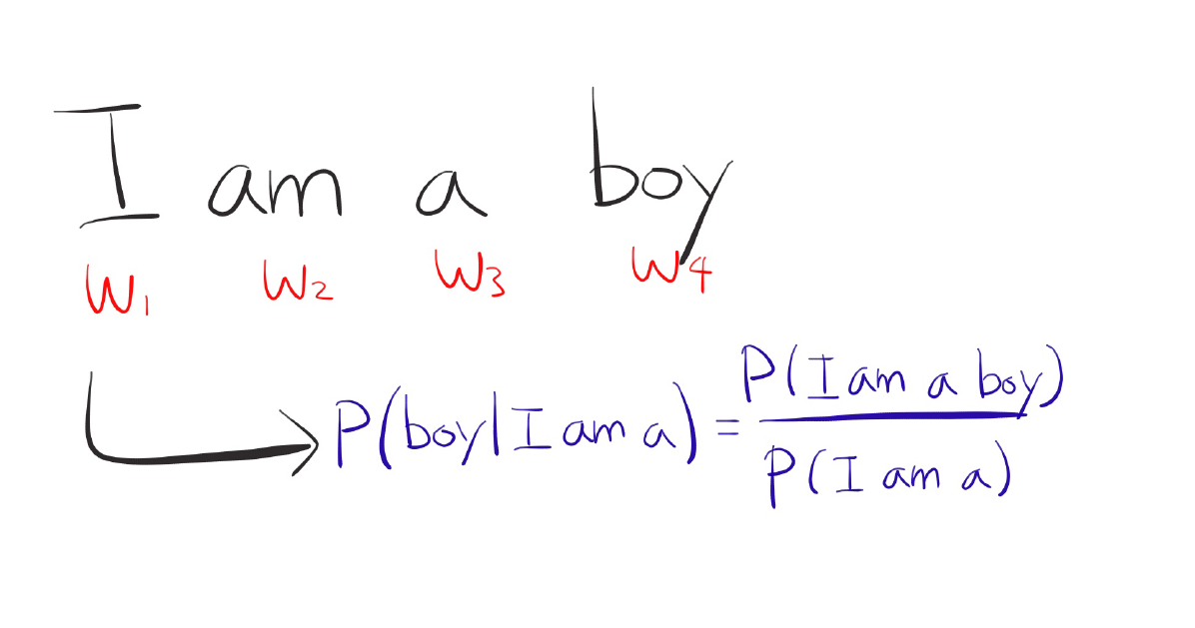
N-Grams

Slide 4
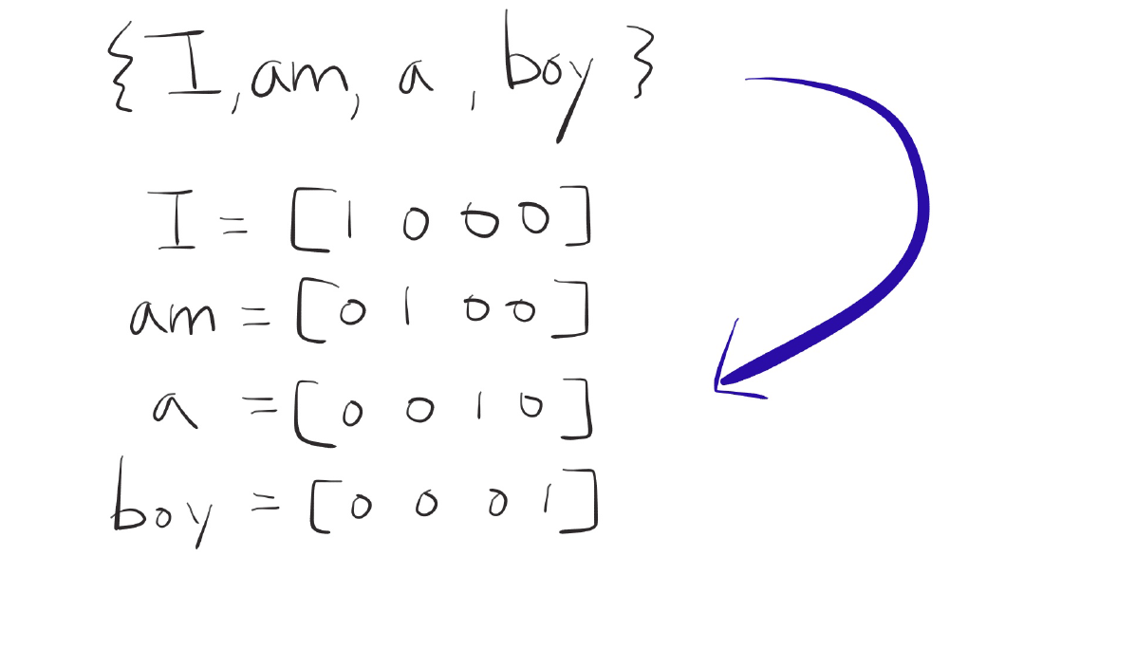
One-hot Representation

Slide 5
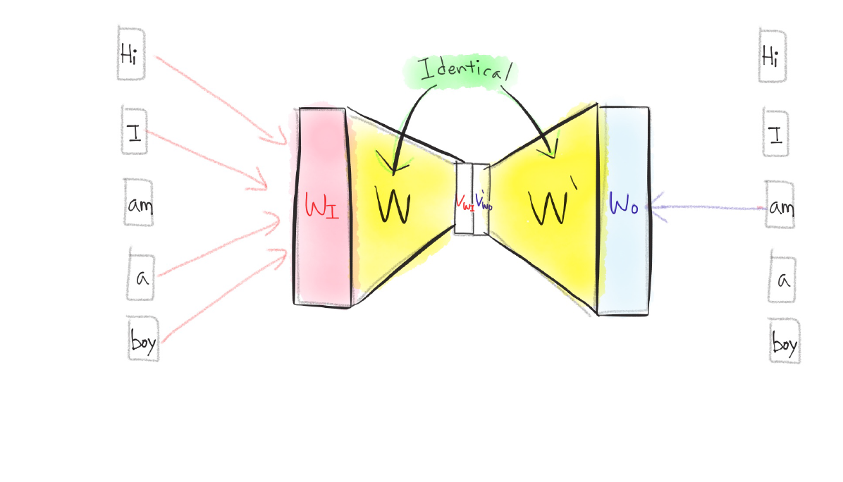
CBOW (Continuous Bag of Words)

Slide 6
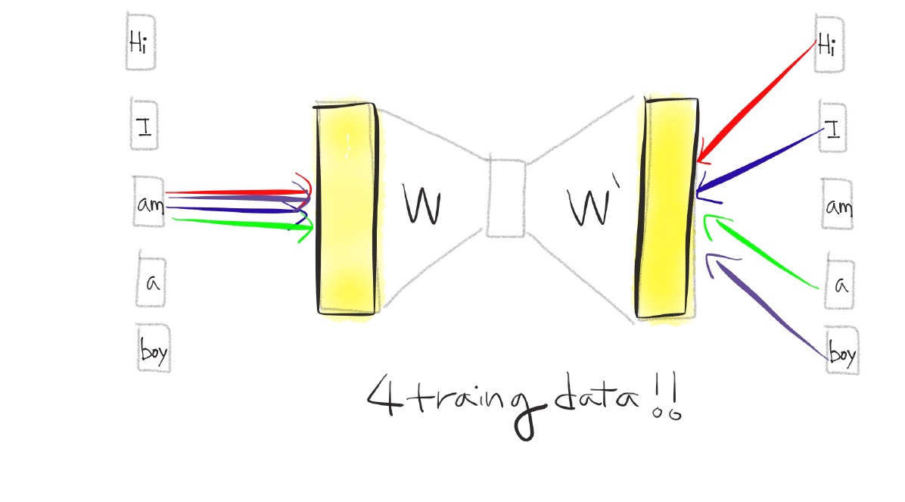
Skip-gram

Slide 7
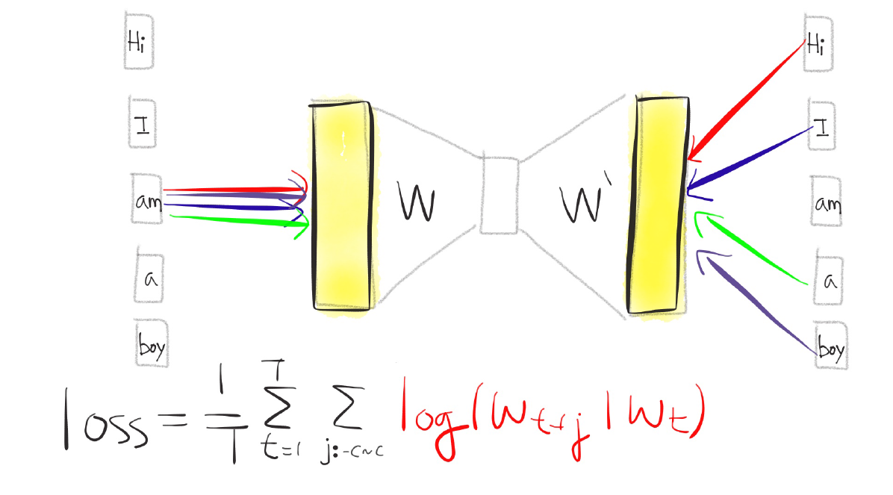
Skip-gram

Slide 8
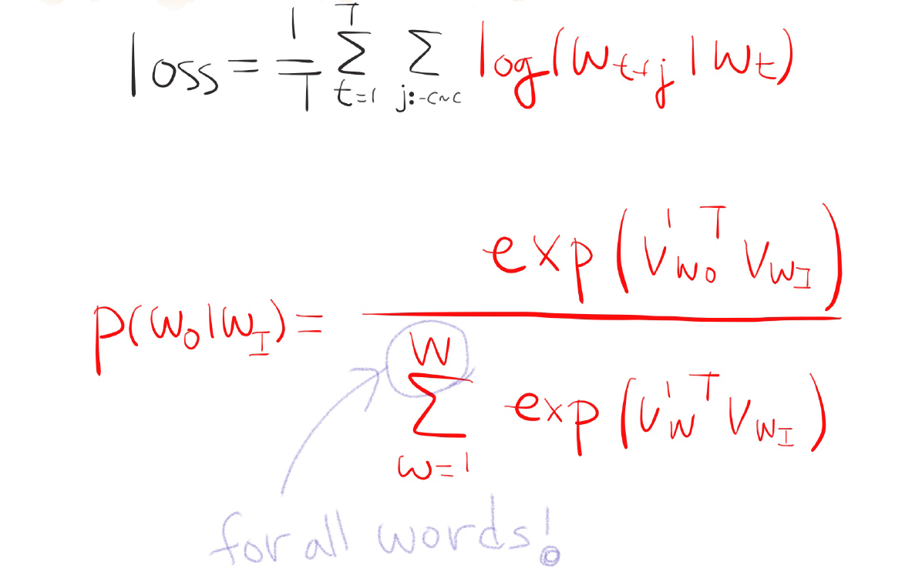
Loss Function

Slide 9
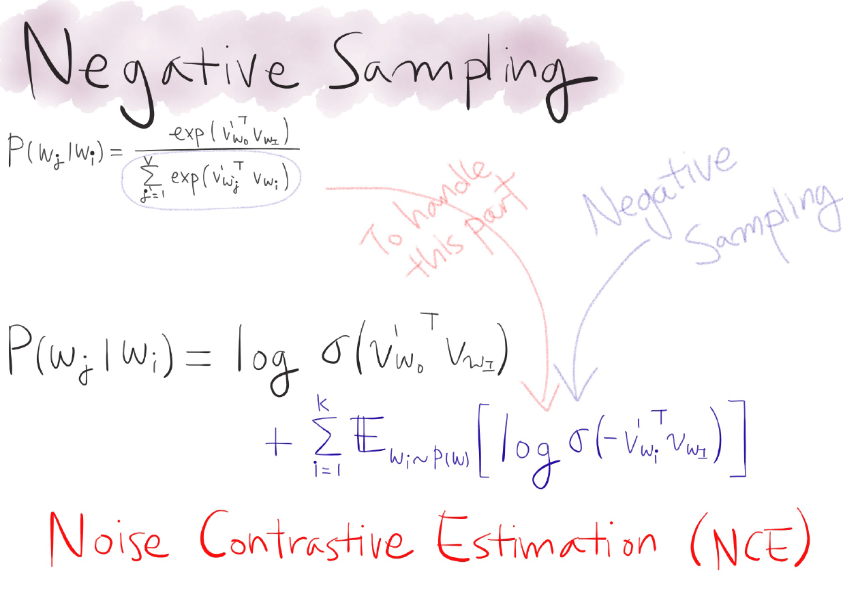

Slide 10
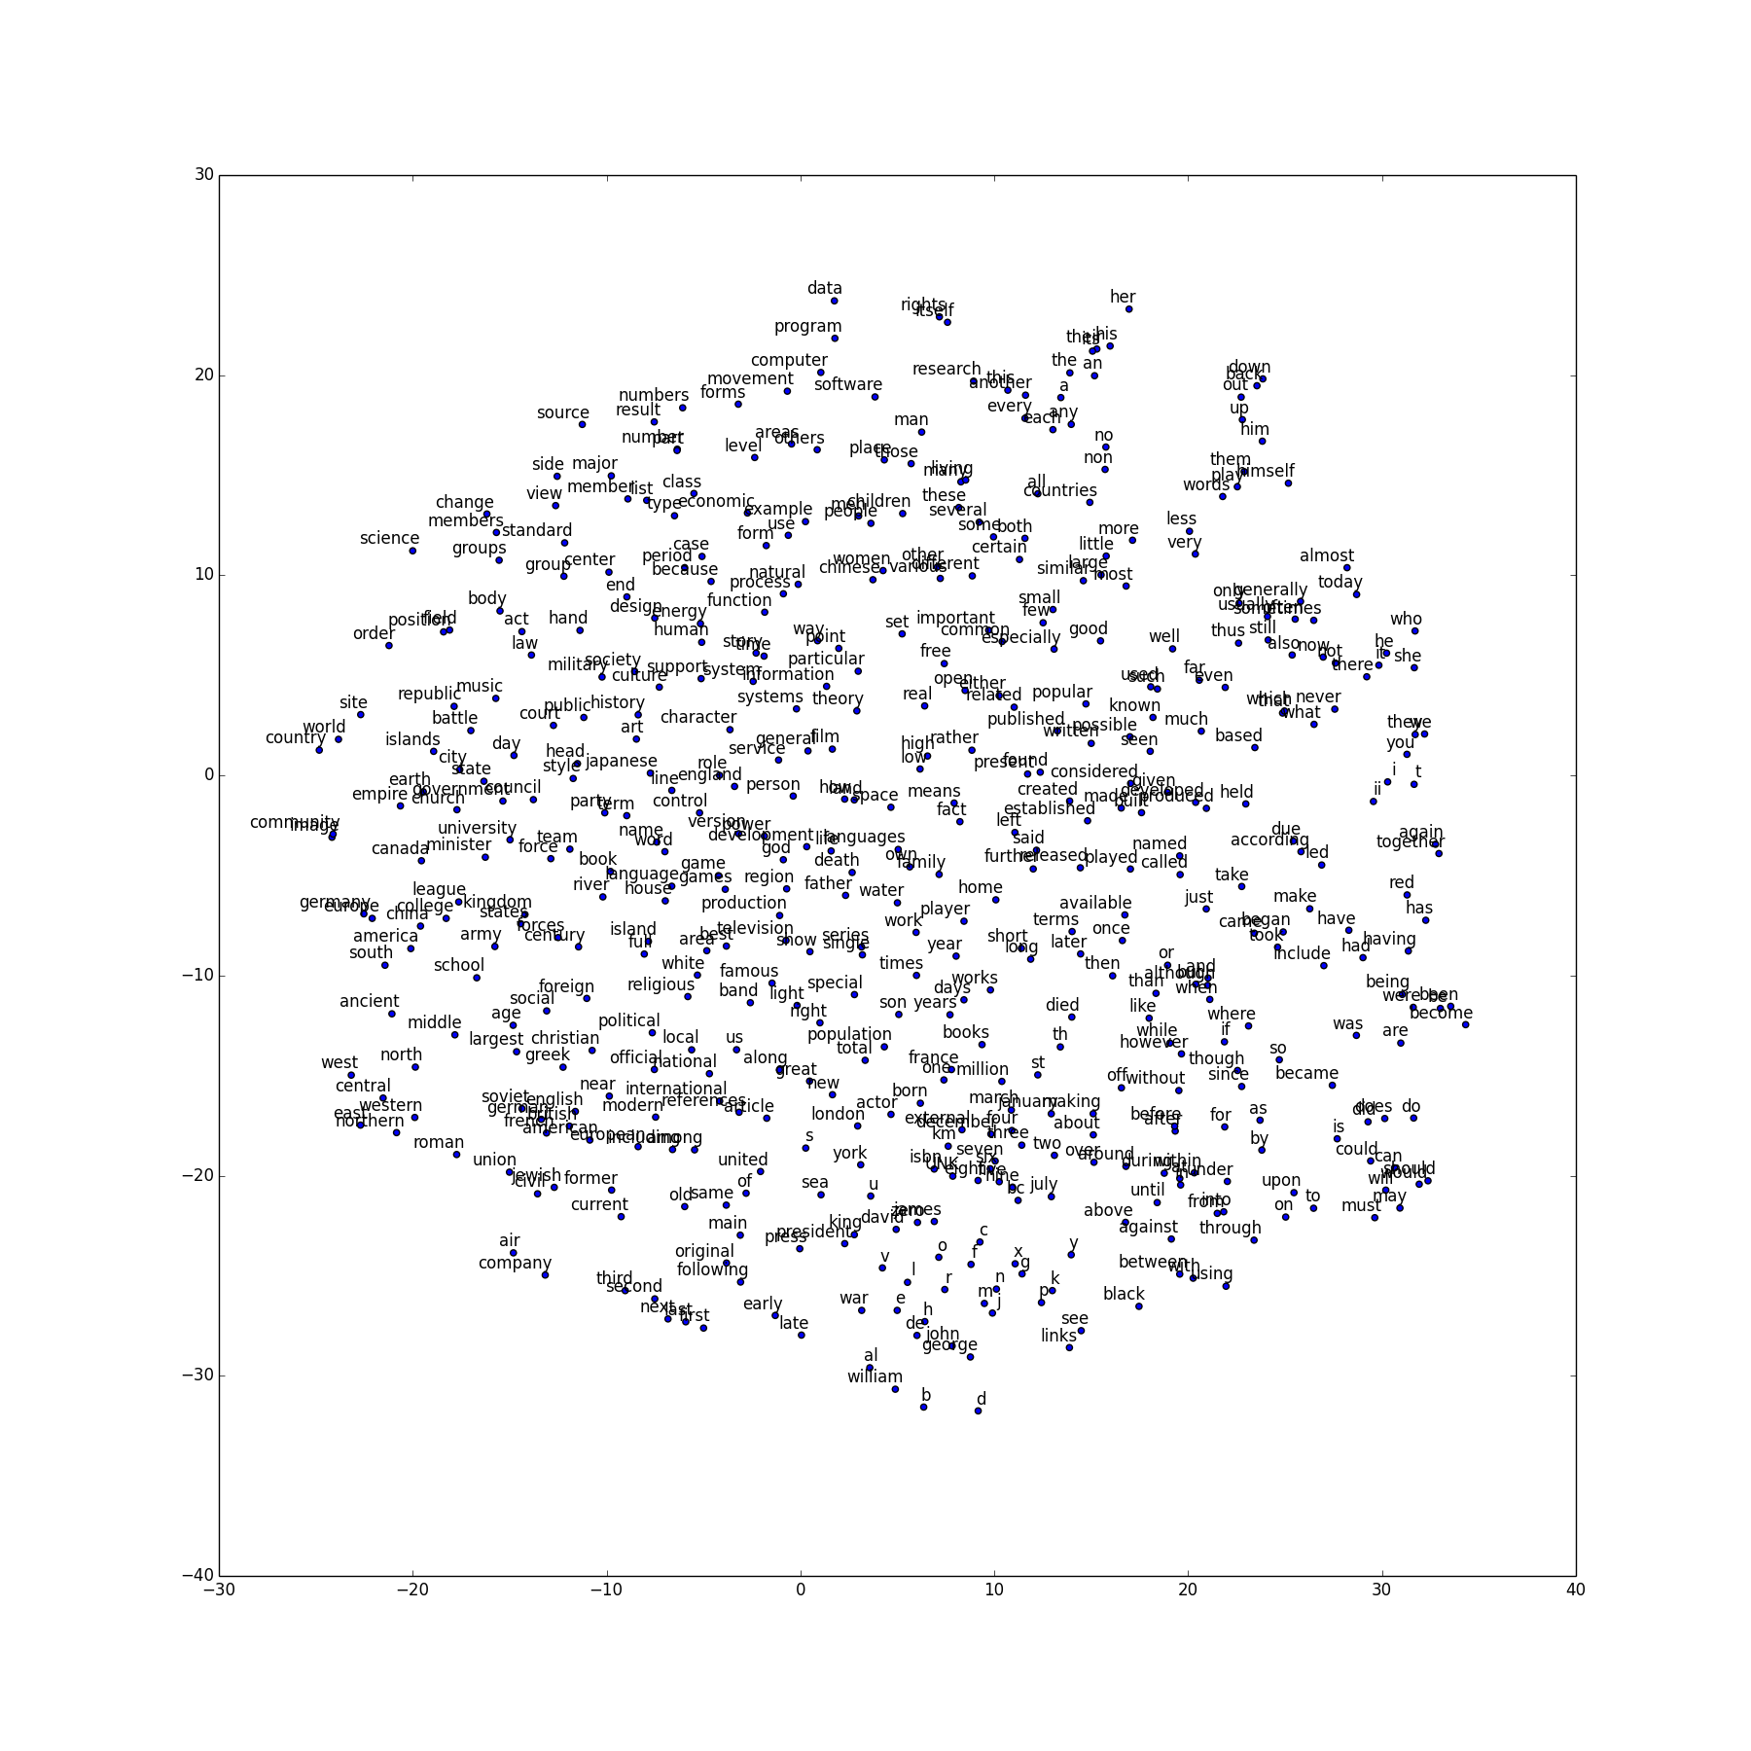
Visualization with t-SNE

Slide 11
Visualization with t-SNE

Slide 12
Visualization with t-SNE

